Slide 1
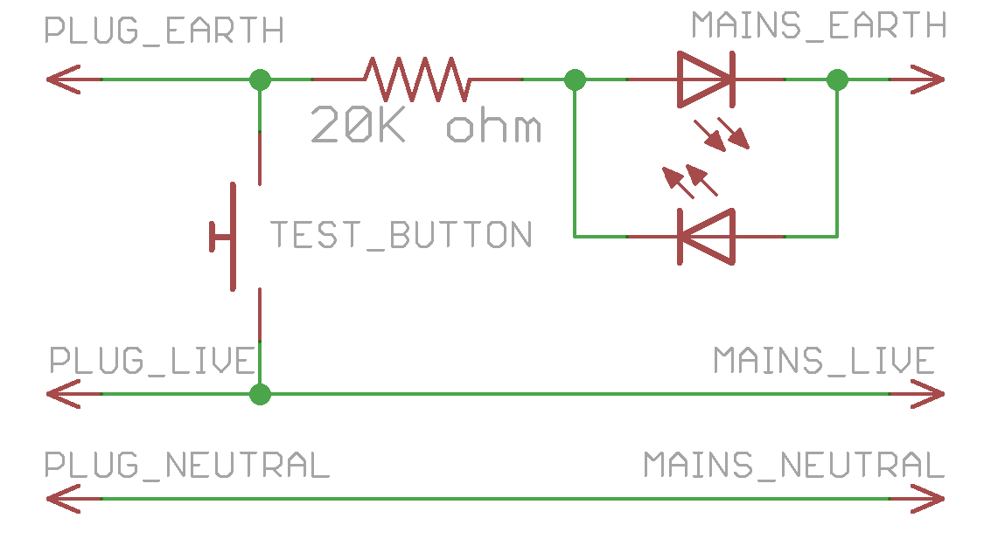
Trip 10mA RCCB only tool instructions
1. Do NOT set up without prior training.
2. Must plug DIRECTLY to 10mA RCCB/RCBO
3. Always test before use.
Red LED should blink for an instant
Only the 10mA RCCB should trip
4. All other RK electrical connections
will be connected to this bar.
ALWAYS TEST BEFORE USE
Only 10mA RCCB trips -> Working
If in doubt, ask Kheng Meng ☺

